Slide 1

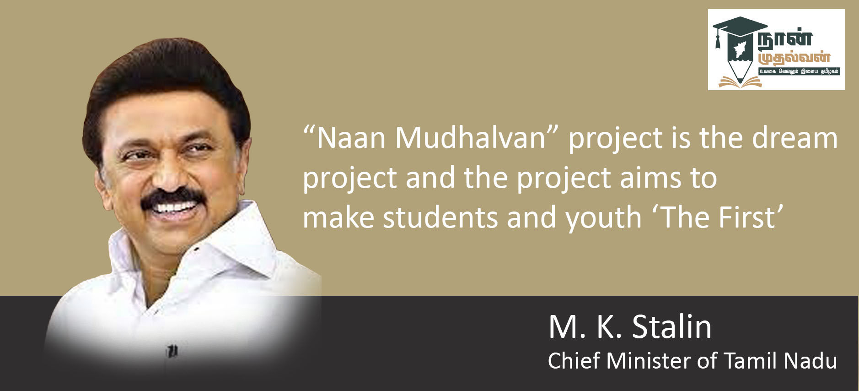
“Naan Mudhalvan” Autodesk Fusion 360 Design challenge
Level 1
College/ Institute name:- AALIM MUHAMMED SALEGH COLLEGE OF ENGINEERING
Group ID:- AUFDC20222617
Student names: F. Khaja Ezzazudtheen Ahamed, Jogeshware Rao
Mentor Name:- E.Vivekanand

Slide 2
AFFORDABLE PERSONAL GYM KIT
Introduction
Introducing our stool that turn into a personal gym kit.
Stool helps to give a full body workout.
Stool it contains 20 plus excercises.

Slide 3
Scope of Work
To reduce the cost of personal gym equipment.
To reduce the size of personal gym equipment.
Can be affordable by all class of people.

Slide 4
Design Objectives (10%)
Helps to achieve fitness in day to day life.
To make more affordable for public.
Try to achieve full body workout for people in compact space.
Try to make 2in p1 product that can be used as stool and also it can be converted into personal gym kit.

Slide 5
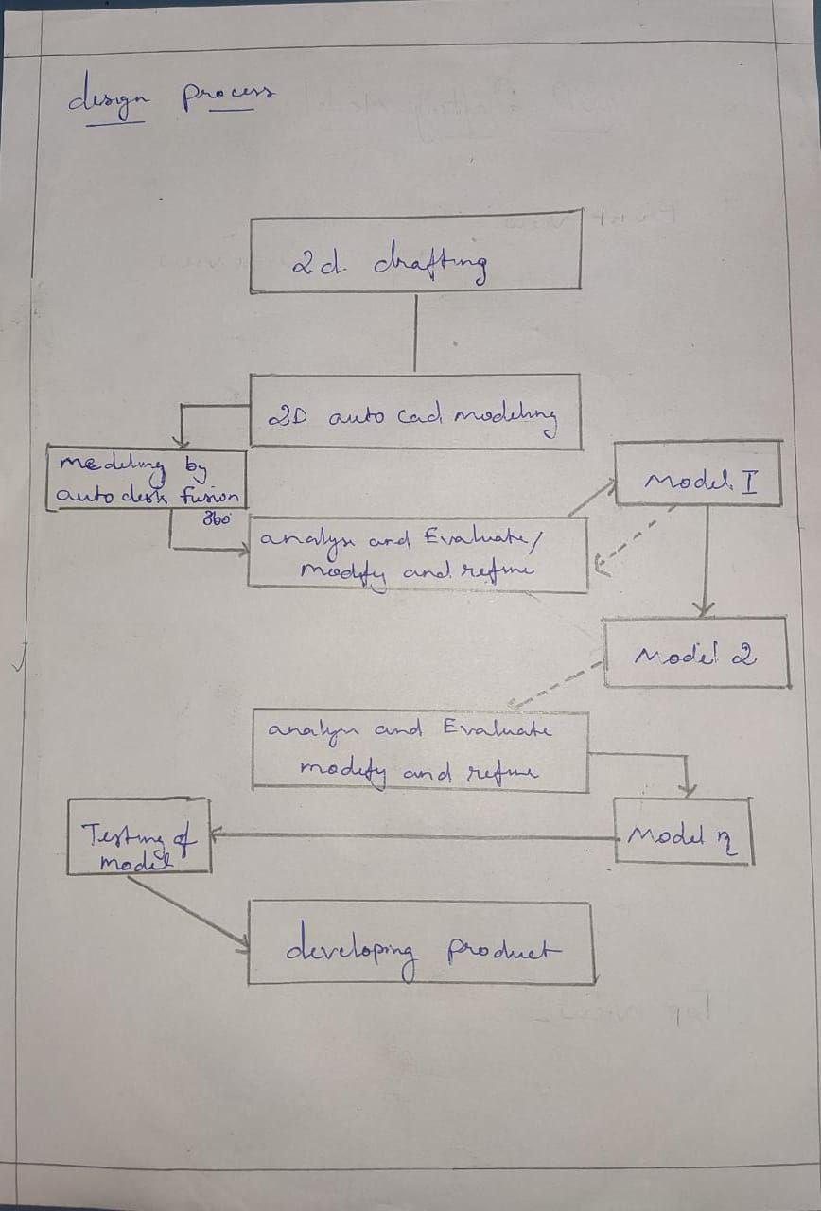
Design Process (10%)

Slide 6
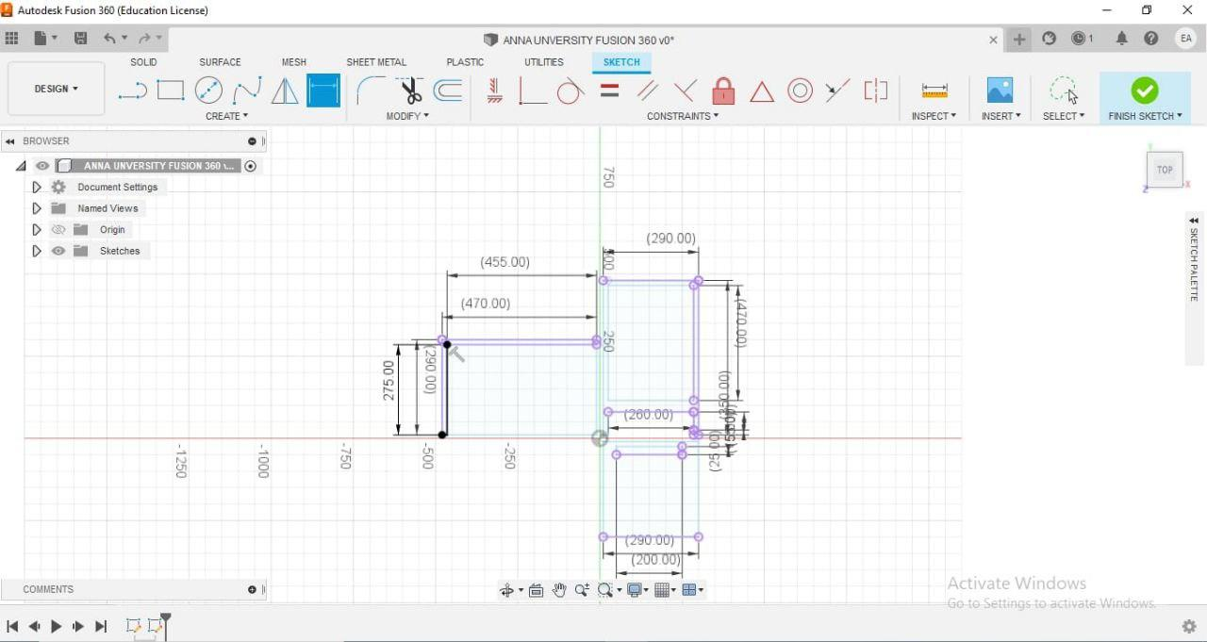
Hi Res. Images

Slide 7
